Slide 1

RV Institute of Technology and Management
Department of Computer/Information Science and Engineering
JP Nagar, Kothanur, Bengaluru - 560076
DAA Lab - Mini Project
Implementation of Round Robin Scheduling Algorithm with Different Arrival Times
Aadarsh Raj
1RF19IS001
ISE
Batch - B1
Deepak DJ
Assistant Professor
Dept. ISE RVITM
Bengaluru - 560076

Slide 2
Agenda
Introduction
Literature Survey
Existing System
Proposed System
Design and Working
Results
Conclusion and Future Scope
References

Slide 3
Introduction
The name of this algorithm comes from the round-robin principle, where each person gets an equal share of something in turns. It is the oldest, simplest scheduling algorithm, which is mostly used for multitasking.
In Round-robin scheduling, each ready task runs turn by turn only in a cyclic queue for a limited time slice. This algorithm also offers starvation free execution of processes.

Slide 4
Literature Survey
CPU Scheduling:
CPU scheduling is a process which allows one process to use the CPU while the execution of another process is on hold (in waiting state) due to unavailability of any resource like input/output etc, thereby making full use of CPU. The aim of CPU scheduling is to make the system efficient, fast and fare.
CPU Utilization: To make the best use of CPU and not waste any CPU cycle, CPU would be working most of the time (Ideally 100% of the time). Considering a real system, CPU usage should range from 40% (lightly loaded) to 90% (heavily loaded).
Throughput: It is the total number of processes completed per unit time or rather say total amount of work done in a unit of time. This may range from 10/second to 1/hour depending on the specific processes.

Slide 5
Turnaround Time: Turnaround time may simply deal with the total time it takes for a program to provide the required output, means the amount of time taken to fulfil a request. The concept thus overlaps with lead time and can be contrasted with cycle time. In computing, turnaround time is the total time taken between the submission of a program/process/thread/task for execution and the return of the complete output to the customer/user. It may vary for various programming languages depending on the developer of the software or the program e user after the program is started.
Arrival Time: Respect to a process, Arrival Time is the Time at which the process arrives in the ready queue. Completion Scheduling of processes/work is done to finish the work on time.

Slide 6
Burst Time: Burst Time is actually time that is required to complete execution of particular task or process. CPU Scheduling algorithms require Burst time as input.
Waiting Time: Throughput: number of processes completed per unit time. Turnaround Time: mean time from submission to completion of process. Waiting Time: Amount of time spent ready to run but not running. Response Time: Time between submission of requests and first response to the request.
Context Switching: A context switching is a process that involves switching of the CPU from one process or task to another. In this phenomenon, the execution of the process that is present in the running state is suspended by the kernel and another process that is present in the ready state is executed by the CPU.

Slide 7
TIME QUANTUM: A special kind of an input is given with a specific time slice which is fixed, based on which processes are terminated.

Slide 8
Round Robin Algorithm
The scheduler assigns a fixed time unit per process, and cycles through them.
RR scheduling involves extensive overhead, especially with a small time unit.
Balanced throughput between FCFS and SJF, shorter jobs are completed faster than in FCFS and longer processes are completed faster than in SJF.
Fastest average response time, waiting time is dependent on number of processes, and not average process length.
Because of high waiting times, deadlines are rarely met in a pure RR system.
Starvation can never occur, since no priority is given.
Order of time unit allocation is based upon process arrival time, similar to FCFS.

Slide 9
Advantages:-
Every process gets an equal share of the CPU.
RR is cyclic in nature, so there is no starvation.
Disadvantages:-
Setting the quantum too short, increases the overhead and lowers the CPU efficiency, but setting it too long may cause poor response to short processes.
Average waiting time under the RR policy is often long.

Slide 10
Round Robin Scheduling Algorithm with Different Arrival Times
In this project we are going to give Arrival Time to each process, and this algorithm which assigns time slice to each process in equal portions and in circular order, handling all processes without priority (also known as cyclic executive). Round-robin scheduling is both simple and easy to implement, and starvation -free. Round-Robin scheduling can also be applied to other scheduling problems, such as data packet scheduling in computer networks. Round robin is most efficiently used method in operating system.

Slide 11
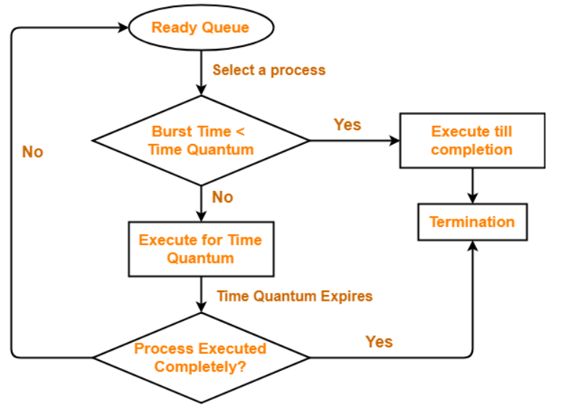
Design and Working
Round – Robin Scheduling

Slide 12
Example 1:
Processes = 4
Time Quantum = 2
Process | Arrival Time | Burst Time | Completion Time | Turnaround Time | Waiting Time
1 | 0 | 5 -> 3 -> 1 | 12 | 12 | 7
2 | 1 | 4 -> 2 | 11 | 10 | 6
3 | 2 | 2 | 9 | 4 | 2
4 | 3 | 1 | 6 | 6 | 5
Ready Queue
P1 | P2 | P3 | P1 | P4 | P2 | P1
Gantt Chart
P1 | P2 | P3 | P1 | P4 | P2 | P1
0 2 4 6 8 9 11 12

Slide 13
Completion Time = Last Time in Running Queue
Turnaround Time = (Completion Time – Arrival Time)
Waiting Time = (Turnaround Time – Arrival Time)
Number of Context Switching = 6
Average Turnaround Time = (Total Turnaround Time / Total Processes)
= (12+10+4+6) / 4
= 8
Average Waiting Time = (Total Waiting Time / Total Processes)
= (7+6+2+5) / 4
= 5

Slide 14
Example 2:
Processes = 5
Time Quantum = 3
Process | Arrival Time | Burst Time | Completion Time | Turnaround Time | Waiting Time
1 | 3 | 5 -> 2 | 17 | 14 | 9
2 | 4 | 6 -> 3 | 23 | 19 | 13
3 | 5 | 8 -> 5 -> 2 | 32 | 27 | 19
4 | 6 | 7 -> 4 -> 1 | 33 | 27 | 20
5 | 7 | 4 -> 1 | 30 | 23 | 19
Ready Queue
P1 | P2 | P3 | P4 | P1 | P5 | P2 | P3 | P4 | P5 | P3 | P4
Gantt Chart
P1 | P2 | P3 | P4 | P1 | P5 | P2 | P3 | P4 | P5 | P3 | P4
3 6 9 12 15 17 20 23 26 29 30 32 33

Slide 15
Completion Time = Last Time in Running Queue
Turnaround Time = (Completion Time – Arrival Time)
Waiting Time = (Turnaround Time – Arrival Time)
Number of Context Switching = 11
Average Turnaround Time = (Total Turnaround Time / Total Processes)
= (14+19+27+27+23) / 5
= 22
Average Waiting Time = (Total Waiting Time / Total Processes)
= (9+13+19+20+19) / 5
= 16

Slide 16
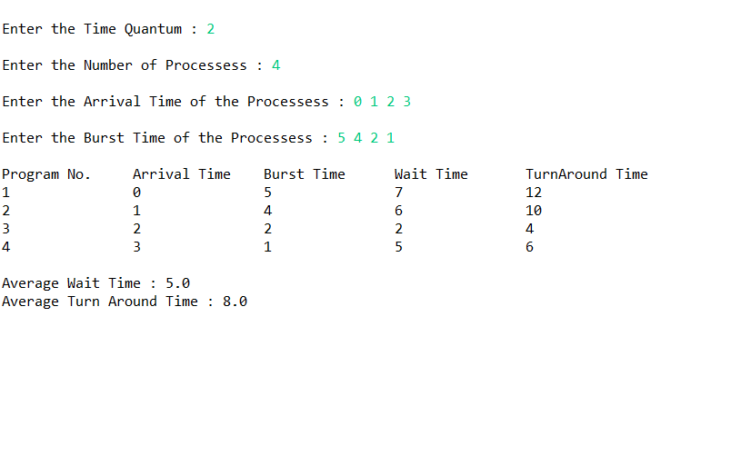
Results
Output for Example 1

Slide 17
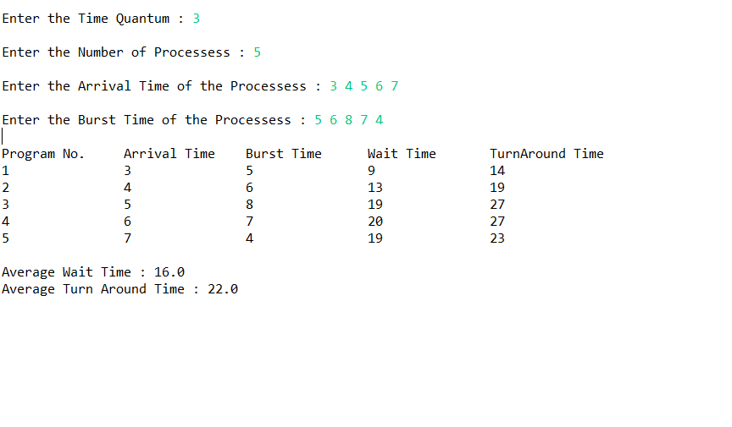
Output for Example 2

Slide 18
Conclusion
So, with these results we get to know that the overall performance of the algorithm depends on
1. Size of the time quantum
If time quantum is large than the CPU burst then this algorithm become same as FCFS and thus performance degrade.
If the time quantum size is very small, then the number of content switches increases and the time quantum almost equal the time taken to switch the CPU from one process to another. Therefore 50% of time spent in switching of processes.
2. Number of contexts switching:
The number of context switches should not be too many to slow down the overall execution of all the processes. Time quantum should be large with respect to the context switch time. This is to ensure that a process keeps CPU for a maximum time as compared to the time spent in the context switching.

Slide 19
Future Scope
Round-robin scheduling can be applied to other scheduling problems, such as data packet scheduling in computer networks, which is an Operating System concept.
Since we know that Round-Robin scheduling algorithm is designed especially for time sharing system. So, in near future we can improve time sharing system by using this algorithm.

Slide 20
References
Modules:
RVITM Modules for Data Structures & Applications (18CS42)
RVITM Modules for Operating Systems (18CS43)
Websites:
https://www.geeksforgeeks.org/
https://en.wikipedia.org/wiki/Main_Page
https://www.youtube.com/c/nesoacademy
Textbooks:
Abraham Silber Schatz, Peter Baer Galvin, Greg Gagne, Operating
System Principles, 7" edition, Wiley-India, 2006.

Slide 21
Thank You

